Slide 1

Jeopardy
Polygons
Parallelograms & Rectangles
Rhombi & Squares
Trapezoids
& Kites
Surprise
Q $100
Q $100
Q $100
Q $100
Q $100
Q $200
Q $200
Q $200
Q $200
Q $200
Q $300
Q $300
Q $300
Q $300
Q $300
Q $400
Q $400
Q $400
Q $400
Q $400
Q $500
Q $500
Q $500
Q $500
Q $500

Slide 2

$100 Question from Polygons
The sum of the interior angles
of a quadrilateral is _____?
41º

Slide 3
$100 Answer from Polygons
^{360 degrees}

Slide 4
$200 Question from Polygons
A hexagon has ____ sides & angles.
A decagon has ____ sides & angles.

Slide 5
$200 Answer from Polygons
6 and 10

Slide 6
$300 Question from Polygons
A polygon that has all sides of the same length and all angles of the same measure is called this.

Slide 7
$300 Answer from Polygons
A regular polygon.

Slide 8
$400 Question from Polygons
How much is one exterior angle of a regular nonagon equal to?

Slide 9
$400 Answer from Polygons
40 degrees

Slide 10

$500 Question from Polygons
What is the value of x for the
following problem?

Slide 11
$500 Answer from Polygons
What is the value of x for the
following problem?
X = 108

Slide 12
$100 Question from Parallelograms & Rectangles
In rectangle ABCD, AC = 7x and BD = 3x + 20. What is the value of x?
xº

Slide 13
$100 Answer from Parallelograms & Rectangles
x = 5.

Slide 14
$200 Question from Parallelograms & Rectangles
ABCD is a parallelogram and angle A = 2x + 40, and angle B = 3x - 10. Solve for x.

Slide 15
$200 Answer from Parallelograms & Rectangles
X=30

Slide 16
$300 Question from Parallelograms & Rectangles
In rectangle ABCD, the diagonals intersect at E. AE = 4x + 20, BC = 7x + 12 and DE = 8x + 4. What is the value of x?

Slide 17
$300 Answer from Parallelograms & Rectangles
x = 4

Slide 18
$400 Question from Parallelograms & Rectangles
What are TWO properties of rectangles that
are NOT properties of parallelograms?

Slide 19
$400 Answer from Parallelograms & Rectangles
4 right angles and the diagonals are congruent

Slide 20
$500 Question from Parallelograms & Rectangles
In parallelogram ABCD, diagonals AC and BD intersect at E. If angle A = 85, and AE = 3x + 10, and EC = 7x - 30, Find the measure of angle C and the value of x.

Slide 21
$500 Answer from Parallelograms & Rectangles
Angle C is 85 degrees, and x = 10, because the diagonals bisect each other.

Slide 22
$100 Question from Rhombi & Squares
In Rhombus MNOP, MN = 24, and NO = 2x + 6. What is the value of x?

Slide 23
$100 Answer from Rhombi & Squares
x = 9

Slide 24
$200 Question from Rhombi & Squares
A square has a side length of x.
What is the perimeter and what is the area?

Slide 25
$200 Answer from Rhombi & Squares
Perimeter = 4x
Area = x²

Slide 26
$300 Question from Rhombi & Squares
In rhombus ABCD, diagonals AC and BD intersect at E. If the measure of angle BAD = 72, what is the measure of angle CED?

Slide 27
$300 Answer from Rhombi & Squares
Angle CED = 54, use the right triangles, and the fact that the angles bisect the corner angles.

Slide 28
$400 Question from Rhombi & Squares
Name the 3 properties that the diagonals of a rhombus have.

Slide 29
$400 Answer from Rhombi & Squares
diagonals bisect each other diagonals are perpendicular diagonals bisect the angles

Slide 30
$500 Question from Rhombi & Squares
Name the properties of a square that a rhombus does NOT have.

Slide 31
$500 Answer from Rhombi & Squares
- Diagonals are congruent
- All 4 angles are right angles

Slide 32
$100 Question from Trapezoids & Kites
Find <M and <O
L
M
110°
42°
O
N

Slide 33
$100 Answer from Trapezoids & Kites
<M=138 and <O = 70

Slide 34
$200 Question from Trapezoids & Kites
What property does a rhombus and a kite have in common?

Slide 35
$200 Answer from Trapezoids & Kites
The diagonals are perpendicular.

Slide 36
$300 Question from Trapezoids & Kites
In a trapezoid, the upper base is 12, and the lower base is 30. What is the median of the trapezoid?

Slide 37
$300 Answer from Trapezoids & Kites
1/2(12 + 30 ) = 1/2(42) = 21

Slide 38
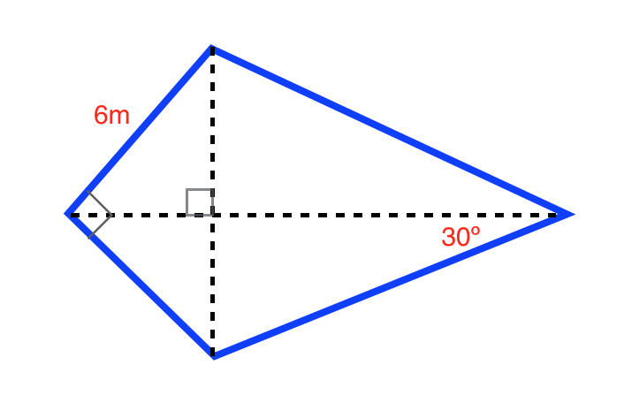
$400 Question from Trapezoids & Kites
x
Solve for x and y
y

Slide 39
$400 Answer from Trapezoids & Kites
Y = 45
X = 60

Slide 40
$500 Question from Trapezoids & Kites
In an isosceles trapezoid, which of the following are NOT true? Choose all that apply.
I.) the diagonals bisect each other
II.) the diagonals are congruent
III.) the upper base angles are congruent IV.) the non parallel sides are congruent

Slide 41
$500 Answer from Trapezoids & Kites
I only.

Slide 42
$100 Question from Surprise!
ABCD is a parallelogram, and AB = 3x - 5, and BC = 6x - 2, and AD = 2x + 12. Solve for x.
a

Slide 43
$100 Answer from Surprise!
X = 3.5

Slide 44
$200 Question from Surprise!
What do the sides of a rectangle add up to?

Slide 45
$200 Answer from Surprise!
The SIDES could ADD to anything. ( The angles add to 360. )

Slide 46
$300 Question from Surprise!
A quadrilateral has the following properties: Its diagonals bisect the angles. Its diagonals are not congruent. Choose any of the following that it could be.
I.) isosceles trapezoid II.) rhombus
III.) rectangle
IV.) parallelogram
V.) square

Slide 47
$300 Answer from Surprise!
II.) rhombus only

Slide 48
$400 Question from Surprise!
List all the quadrilaterals diagonals bisect each other.

Slide 49
$400 Answer from Surprise!
Square
Rhombus
Rectangle
Parallelogram

Slide 50
$500 Question from Surprise!
To prove that a quadrilateral is a kite on the coordinate plane, what can you do?

Slide 51
$500 Answer from Surprise!
Prove that two pairs of consecutive sides are congruent using the distance formula
OR
Prove that diagonals are perpendicular using slope and prove that one diagonal is bisected using midpoint or distance

